Slide 1
Building Plan Management System
Shreya Mehta
Sem VI-A
Roll No.49

Slide 2
Company Name:S2 InfoTech International Limited

Slide 3
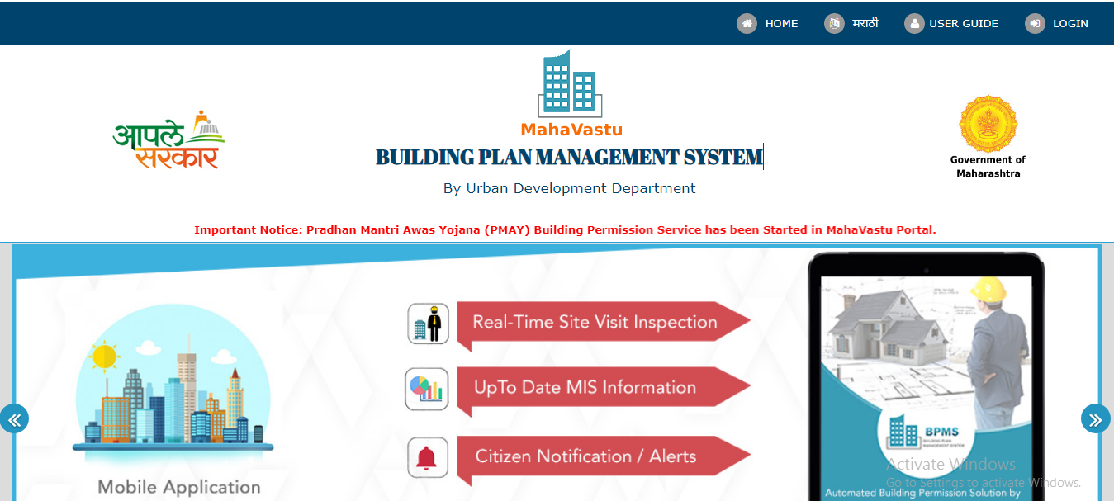
Building Plan Management(Mahavastu)
Subtitle

Slide 4
Building Plan Management, it’s a government-based project creating a software for all the permissions require for the plot/land/constructing a building by owner and technical person to construct a building.
This Plan is only applicable in Maharashtra State right now.

Slide 5
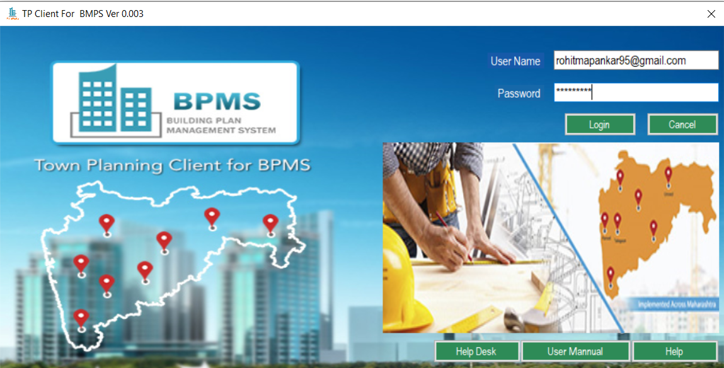
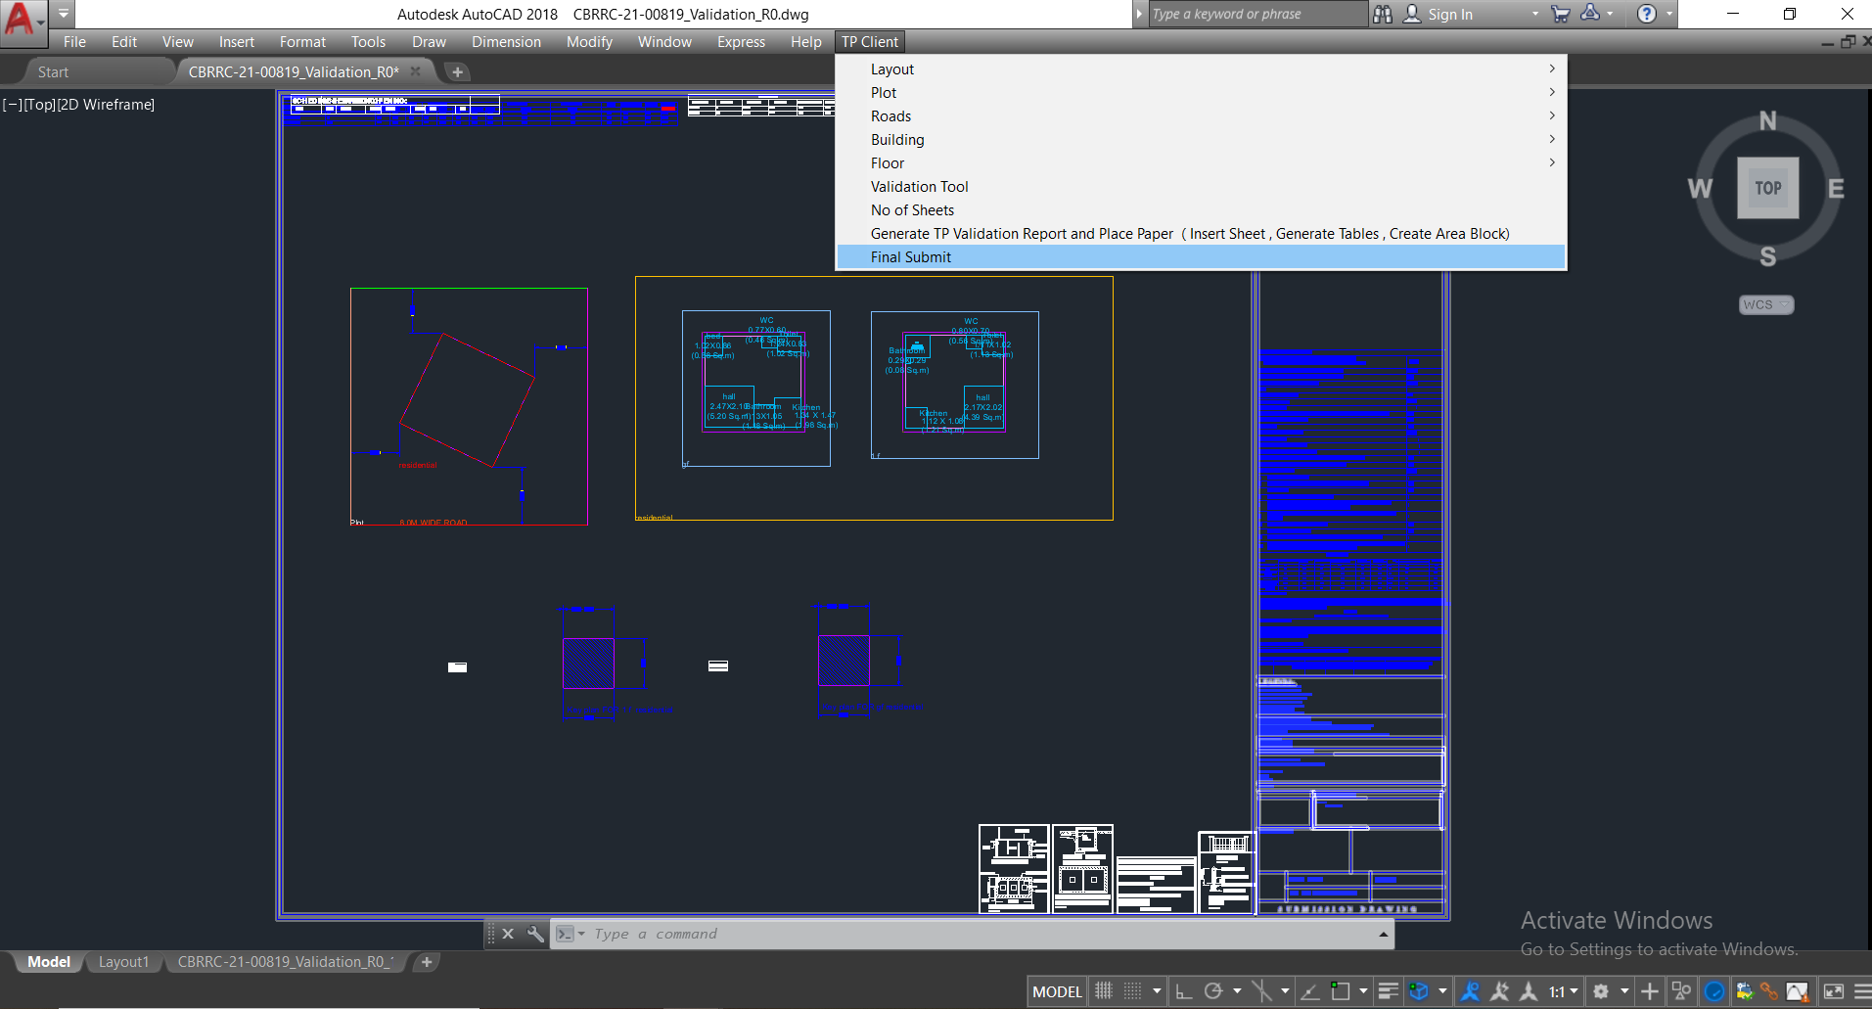
Technology Used
PHP for Portal - BPMS Portal
AutoLib for TP Client- A software to create drawing plan.

Slide 6
My contribution towards this project
Creating Prototype for the TDR screen using pencil tool and excel.
Creating User Manual for the all the process which includes (Building Permission, Moderate Risk Building Permission, Low Risk Building Permission, Renewal Building Permission etc.)
Creating Document for all the process.
Creating workflow for Raise the Ticket Form using Visio software.

Slide 7
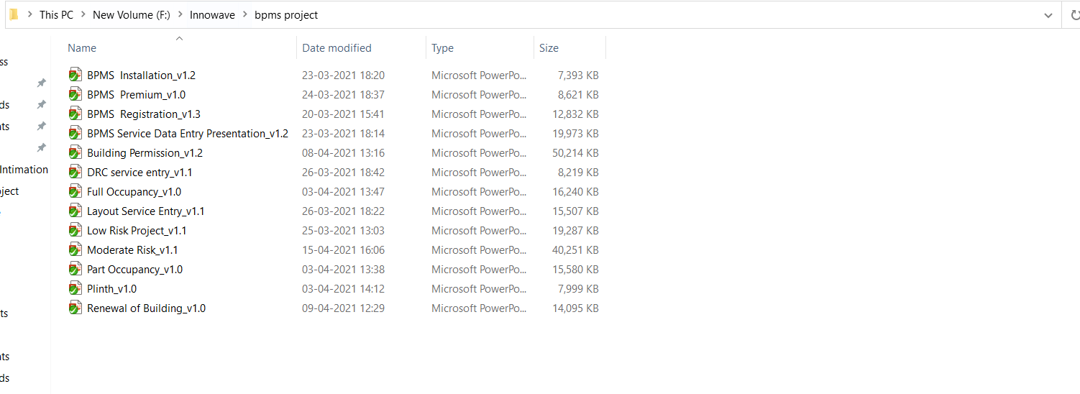
Documentation done up till now.

Slide 8
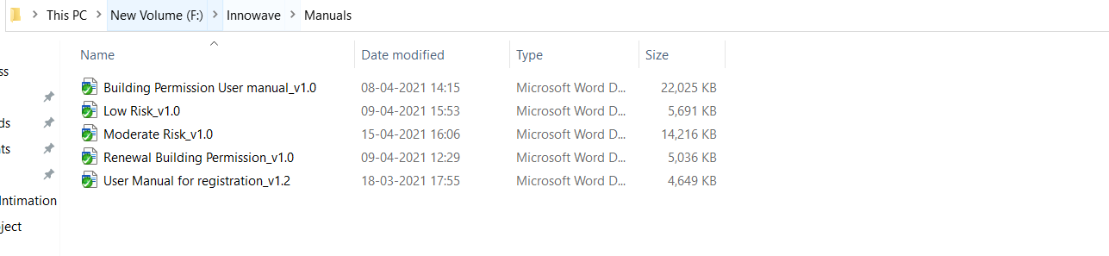
Documentation done up till now.

Slide 9
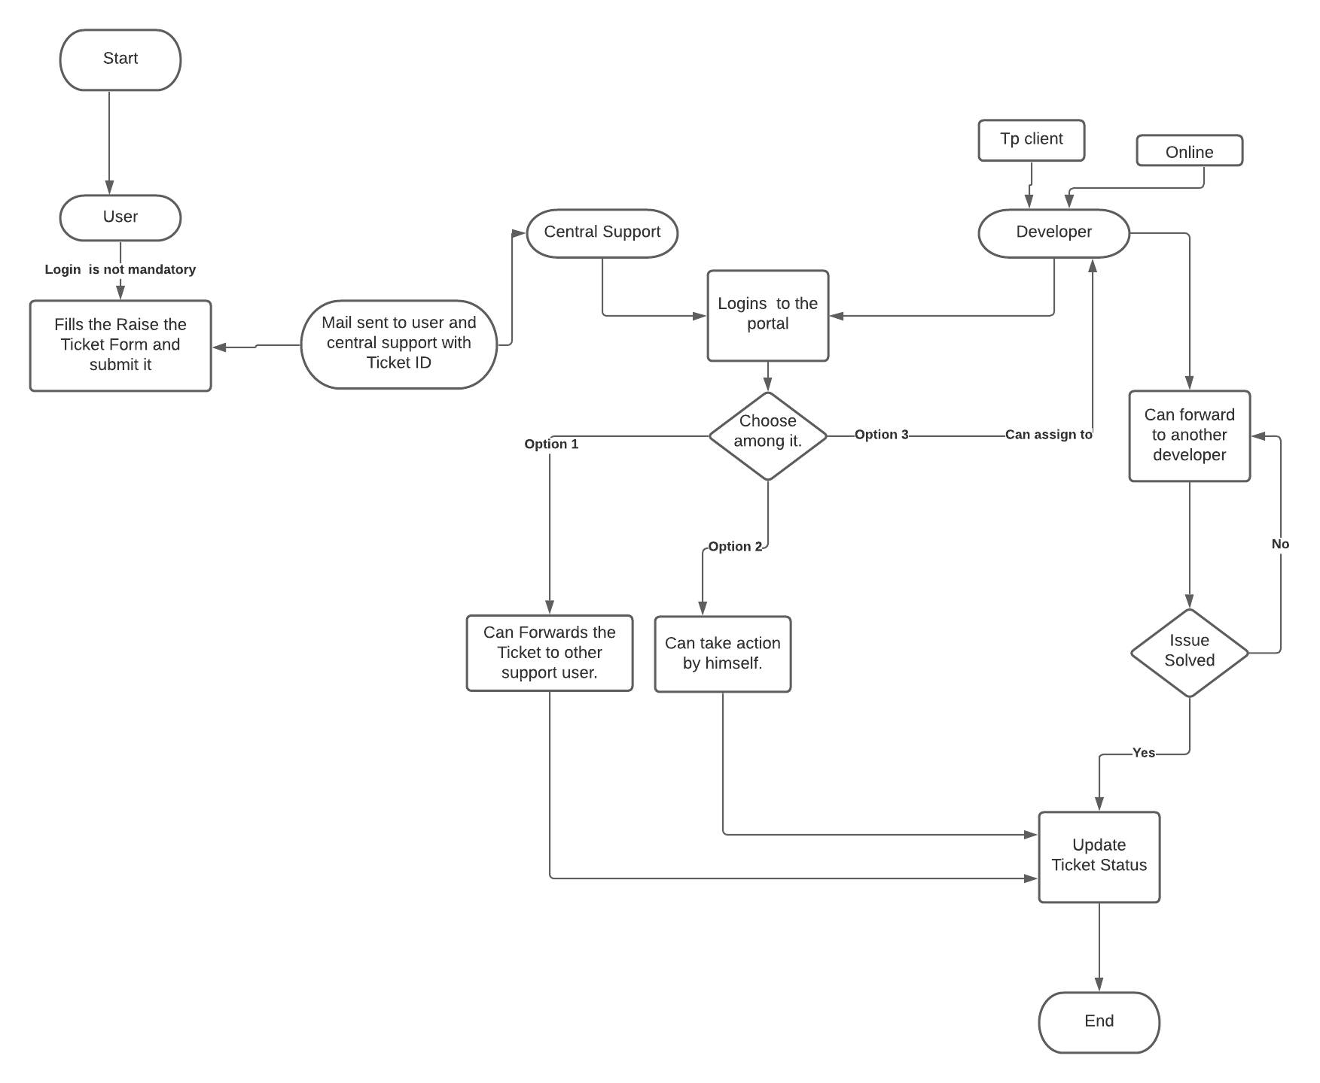
Flow Diagram for Customer raising the Ticket form.

Slide 10
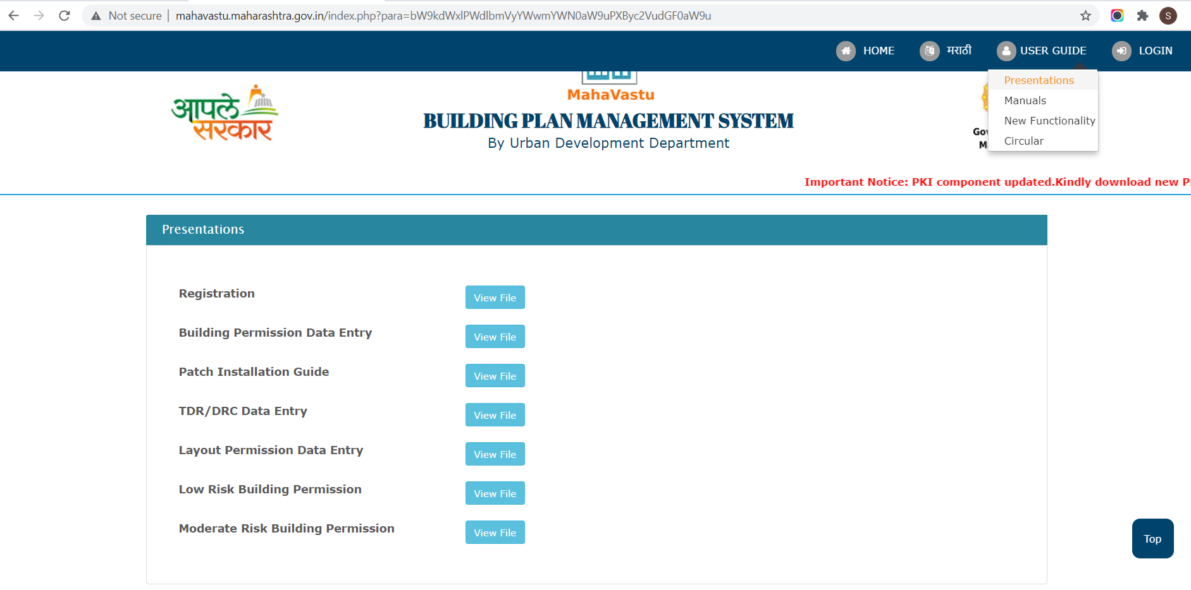
Few of the documents has been uploaded on the website

Slide 11


